Slide 1
Geog 714
Data analysis
Today: Clustering and cluster analysis

Slide 2
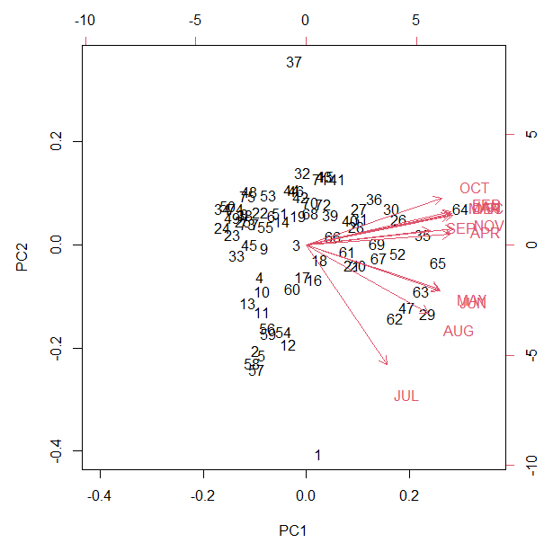

Slide 3
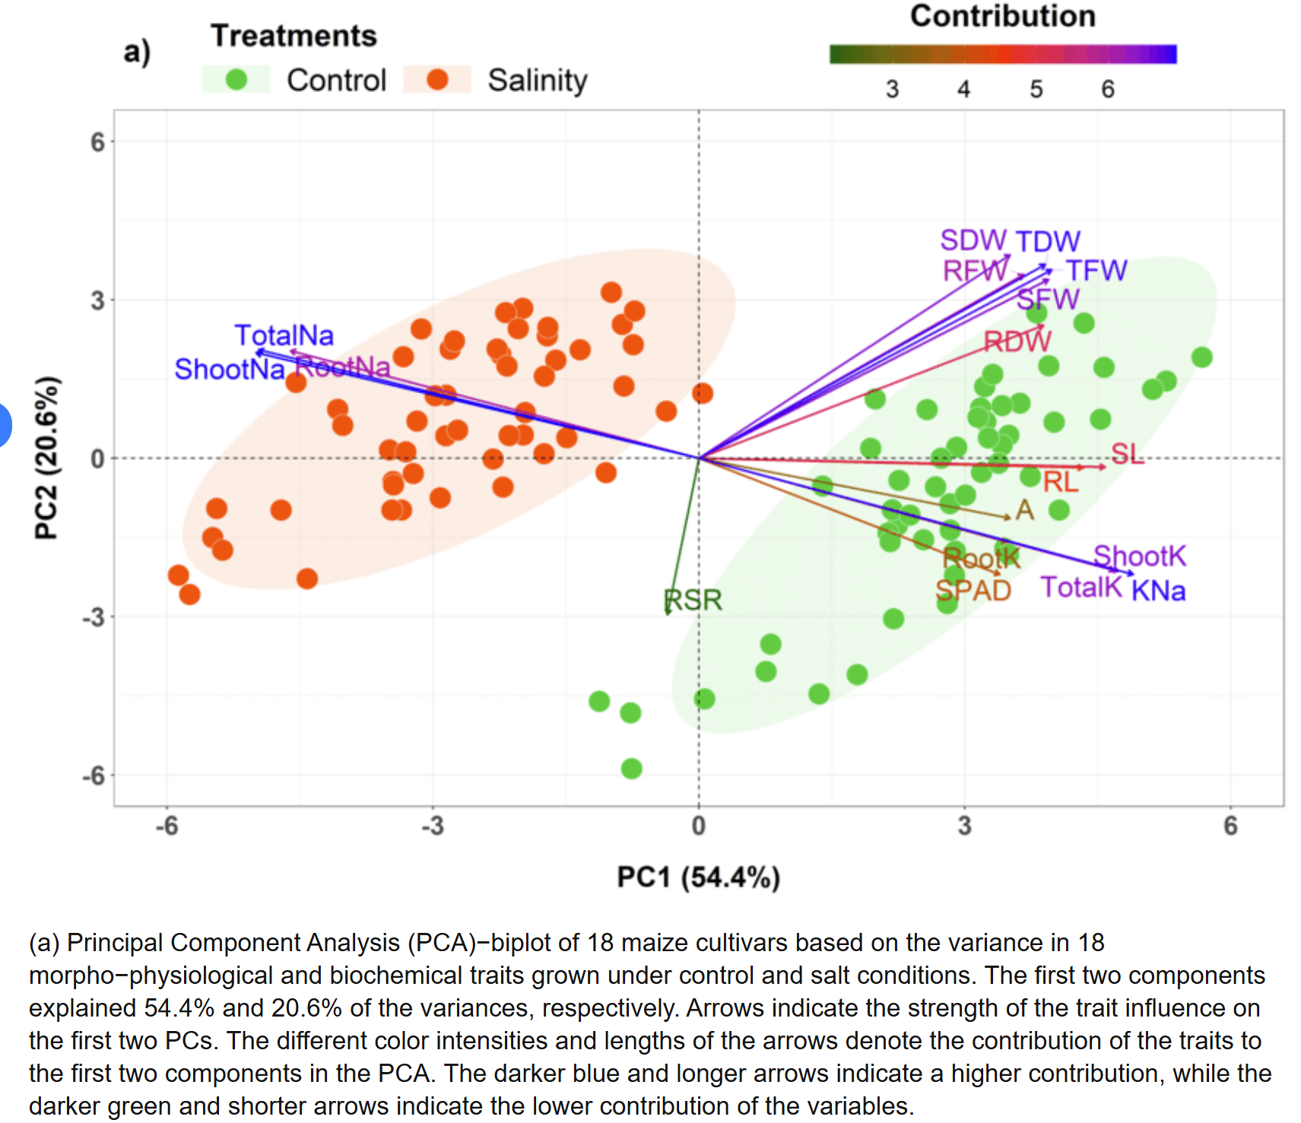

Slide 4
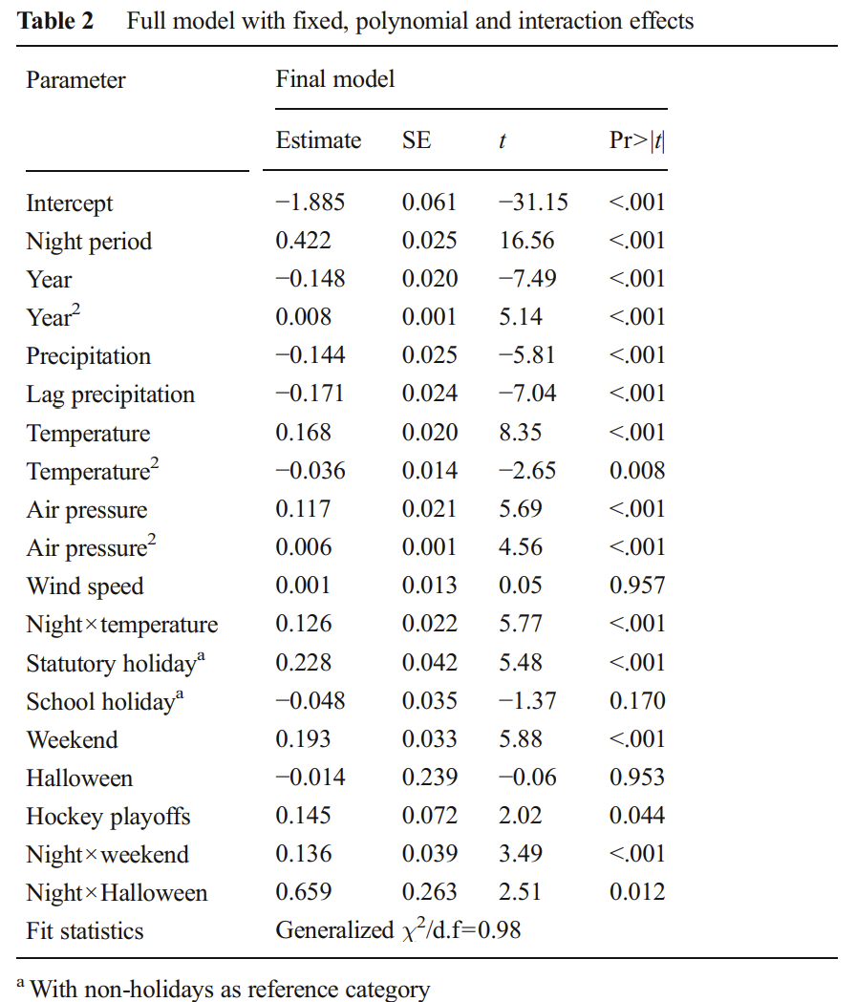
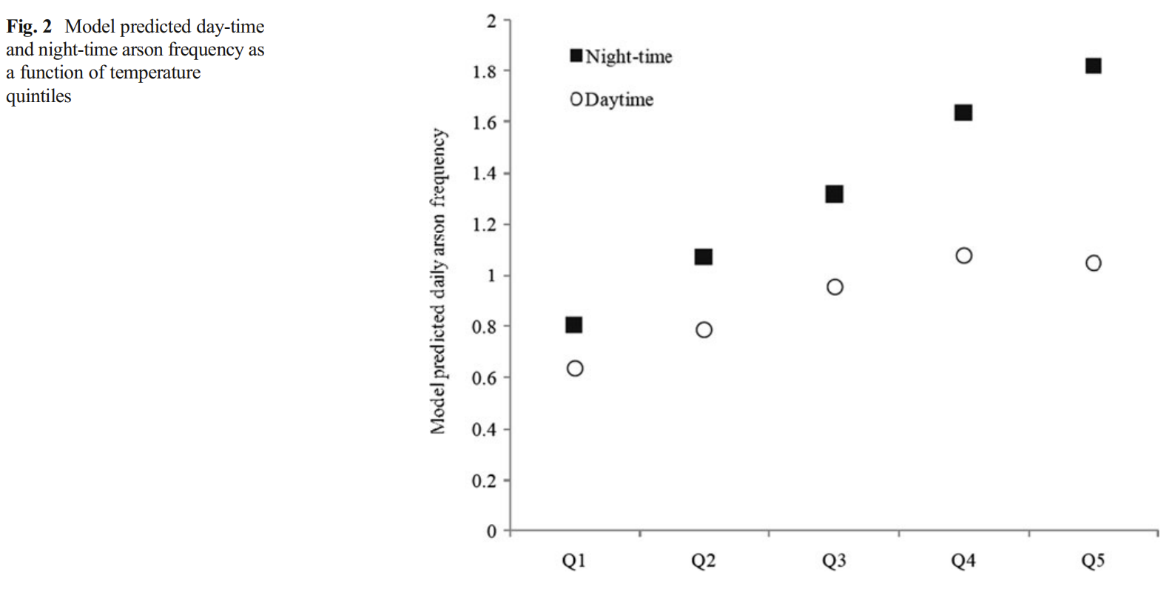

Slide 5
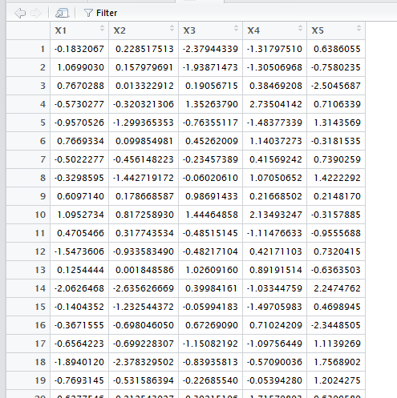
Cluster analysis
Creating groups of observations / subjects / individuals based on some attributes
Exploratory data simplification tool
An art and a science…

Slide 7
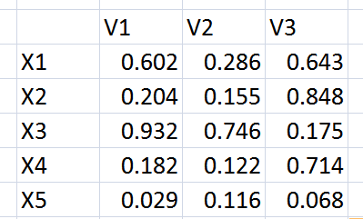
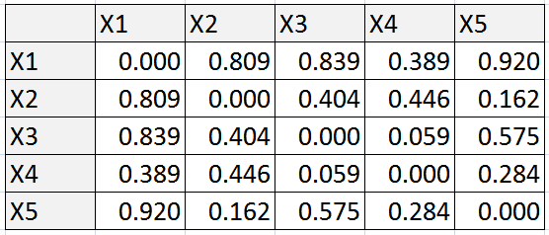
Turn into a distance matrix
Each cell in this table measures distance between observations on all the dimensions (in this case, 3 dimensions)
5 observations (X1-X5), 3 attributes/dimensions (V1-V3)

Slide 8
Possible grouping:
Group 1: X4, X5
Group 2: X3, X1
Group 3: X2
Possible grouping:
Group 1: X2, X5
Group 2: X3, X4
Group 3: X1
Distances can be used to form groups; put ‘near’ observations into the same group
Possible grouping:
Group 1: X2, X5
Group 2: X1, X3, X4
And so on…

Slide 9
Possible grouping:
How do we know which grouping scheme is ‘best’?
Generally, we come up with criteria ahead of time
E.g., find clusters that minimize distances between observations in the same group
Group 1: X4, X5
Group 2: X3, X1
Group 3: X2
Possible grouping:
Group 1: X2, X5
Group 2: X3, X4
Group 3: X1
Possible grouping:
Group 1: X2, X5
Group 2: X1, X3, X4

Slide 10
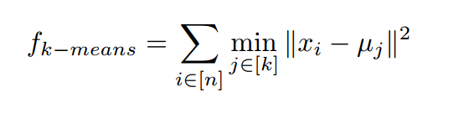
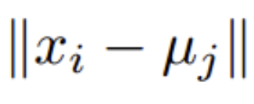
Put individuals into k groups described by an n dimensional vector x in a way that minimizes the squared variation between x_{i} and the group mean (μ_{j})

Slide 12
Lloyd’s algorithm (k-means)
Put i individuals into k groups in a way that minimizes the d dimensional distance between observations and group means
Randomly locate k centroids in d dimensional space
Assign each observation to the closest k centre in d dimensional space
Calculate the mean for all observations in each group, and set these as the new centroids
If convergence criteria is met, stop
Otherwise go back to step 2

Slide 13
Example in 2D space
1. Randomly locate k centroids in d dimensional space

Slide 14
2. Assign each observation to the closest k centre in d dimensional space

Slide 15
3. Calculate the mean for all observations in each group, and set these as the new centroids

Slide 16
2. Assign each observation to the closest k centre in d dimensional space

Slide 17
3. Calculate the mean for all observations in each group, and set these as the new centroids

Slide 18
2. Assign each observation to the closest k centre in d dimensional space

Slide 19
3. Calculate the mean for all observations in each group, and set these as the new centroids
Done if no further improvements

Slide 20
You still must choose the number of clusters ahead of time
Lloyd’s algorithm is fast (even for large data sets) and effective
Must also implicitly or explicitly choose the variable weights
Notes:
Fuzzy and strict partitioning…

Slide 21
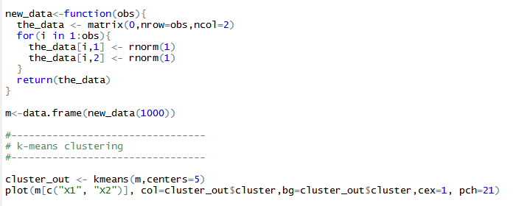
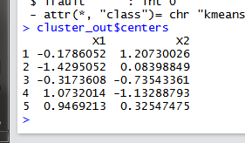

Set the number of cluster centroids

Slide 22
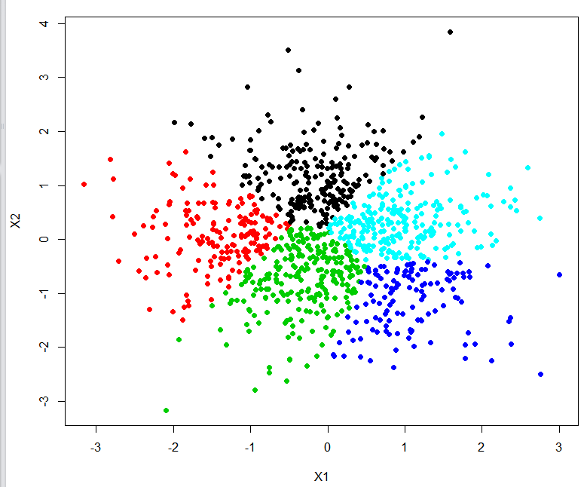

Slide 23
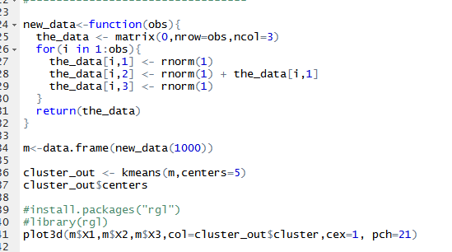

Slide 24
Hierarchical clustering
Make groups based on similarity at multiple levels
See the hierarchical structure of similarity in attributes
Dendrogram

Slide 25
Single linkage agglomerative clustering
Each observation is assigned to a cluster of 1 (itself)
Calculate distance between all clusters
Group the closest pairs of clusters together into a new cluster
If all observations are in the same cluster, stop
Otherwise go back to step 3
Notes:
Agglomerative – start with disaggregate and work your way into groups

Slide 26
Notes:
All points are currently in a cluster of 1

Slide 27
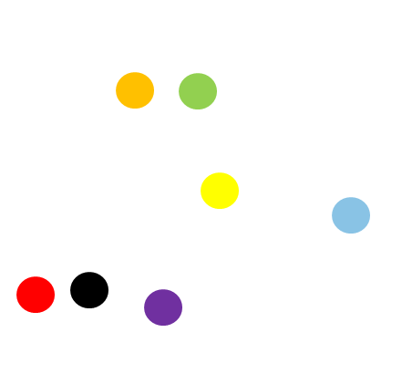

Slide 33
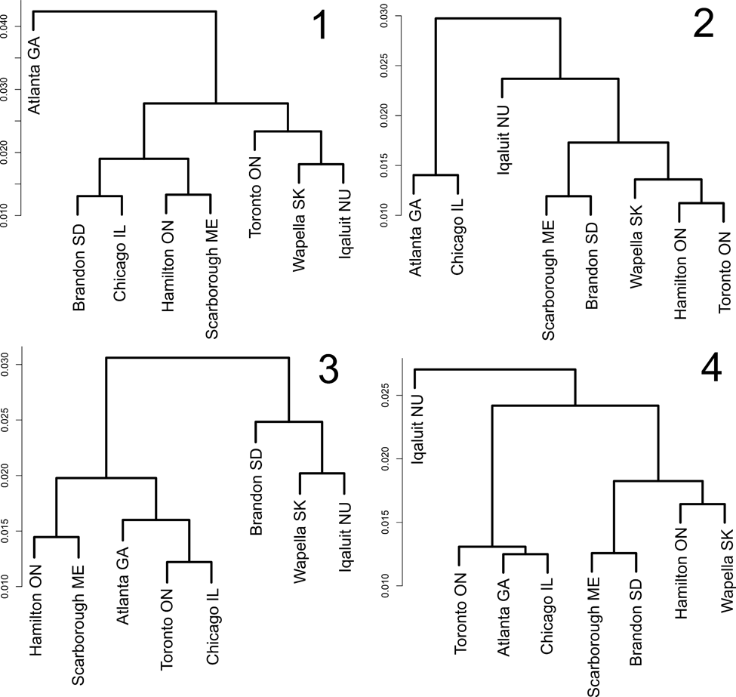
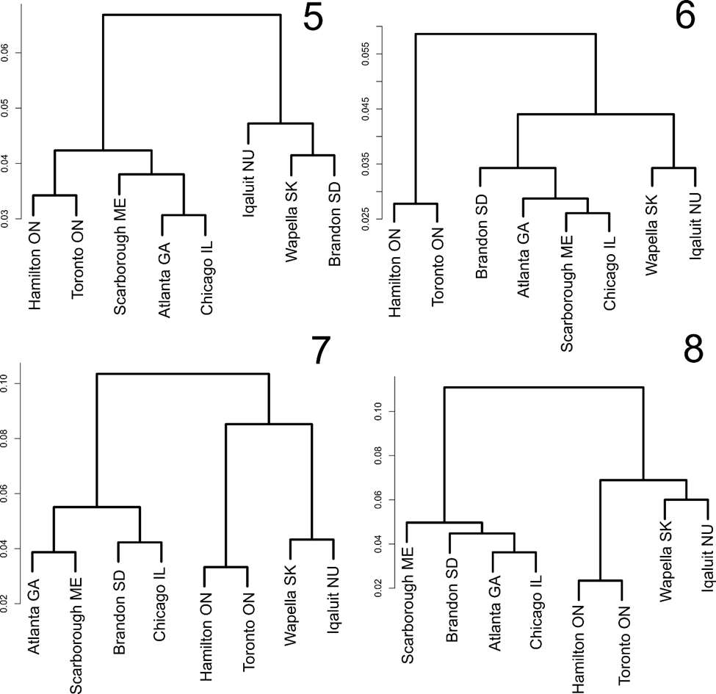

Slide 34
Many cluster distance methods
Single linkage
How close are two clusters? Measured by calculating the minimum distance between points in clusters
Potential for ‘chains’
Complete linkage
How close are two clusters? Measured by calculating the maximum distance between points in clusters
Clusters more clumped together (fewer ‘chains’)
Centroids
How close are two clusters? Measure distance between cluster centroids
Reduces the effect of outlying observations
Ward’s method
How close are two clusters? Measured by looking at the variation within clusters (variation is distance between cluster centroids and the observations in the clusters)

